Slide 1
Facebook Comment Volume
Minería de datos
dfddfghfdhsdfhdfshfshfdshdfshdfshfdshdfshdfshf
2021

Slide 2

Explicación de la base de datos
Características
Número de atributos
Variables
Área al que pertenecen los datos

Slide 3


Problema de aprendizaje supervisado
Regresión
La tarea asociada con la base de datos es predecir cuántos comentarios va a recibir un post.

Slide 4

Descripción Variable Respuesta
No posee valores faltantes
Media (7.32)
Des. Estándar (35.5)
Minimo (0)
Máximo (1.305)

Slide 5
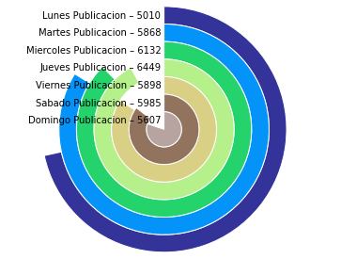
Día en el cual el post fue publicado
Notes:
Source: https://www.sagepeople.com/about-us/news-hub/how-to-identify-develop-high-potential-employees/#
https://www.shl.com/en/solutions/identify-develop-leaders/high-potential/
Saville and Holdsworth Limited (SHL) is an international company that designs personality, behavioural and ability tests.

Slide 6
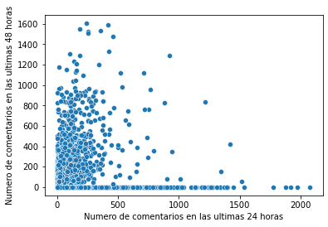
No. de comentarios recibidos de 0 a 24 horas y No. de comentarios recibidos de 24 a 48 horas
Scatter plot
Notes:
Source: https://www.sagepeople.com/about-us/news-hub/how-to-identify-develop-high-potential-employees/#
https://www.shl.com/en/solutions/identify-develop-leaders/high-potential/
Saville and Holdsworth Limited (SHL) is an international company that designs personality, behavioural and ability tests.

Slide 7
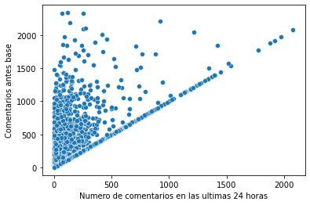
No. de comentarios recibidos de 0 a 24 horas y No. de comentarios recibidos de 48 a 72 horas
Scatter plot
Notes:
Source: https://www.sagepeople.com/about-us/news-hub/how-to-identify-develop-high-potential-employees/#
https://www.shl.com/en/solutions/identify-develop-leaders/high-potential/
Saville and Holdsworth Limited (SHL) is an international company that designs personality, behavioural and ability tests.

Slide 8
Anexos y Bibliografía
Kamaljot (2009), Facebook Comment Volume Dataset Data Set. Lovely Professional University. Jalandhar. India.
Disponible en: https://archive.ics.uci.edu/ml/datasets/Facebook+Comment+Volume+Dataset

Slide 9

¡Gracias!

